Slide 1
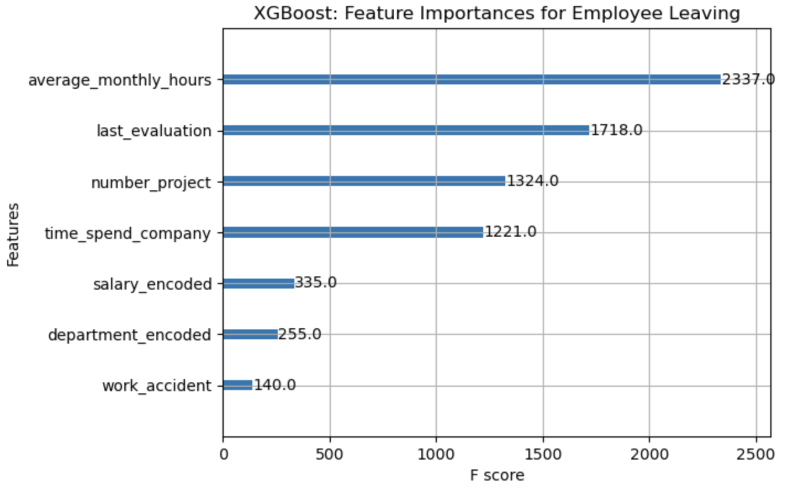
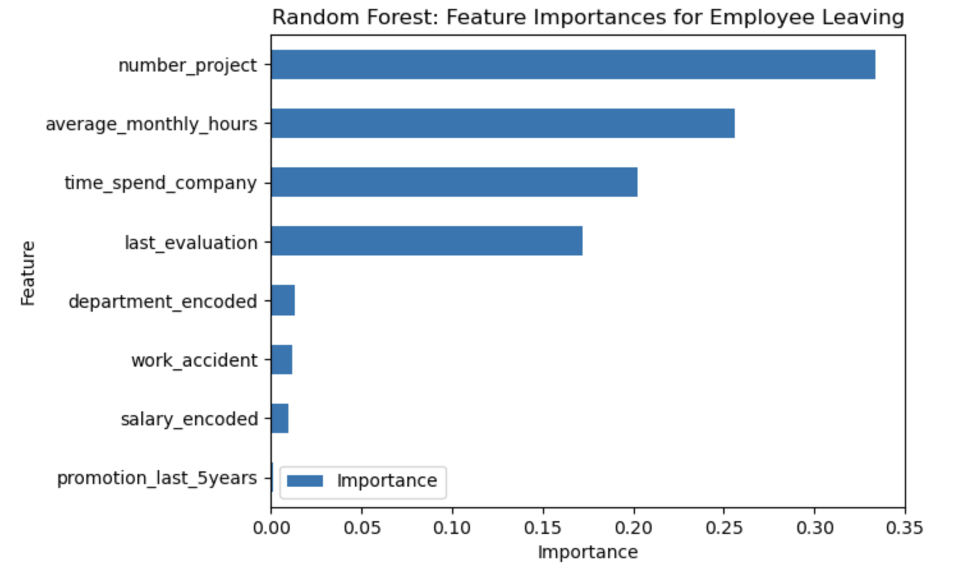
Salifort Motors
Employee Retention Project
Salifort Motors seeks to improve employee retention and identify the factors that make the employees leave the company. This project aims to provide actionable insights for refining organizational strategies, ultimately fostering a workplace environment conducive to both professional growth and sustained success.
The initial approach involves constructing a logistic regression model to analyze employee retention factors. Subsequently, advanced algorithms, namely random forest and XGBoost, will be implemented for enhanced predictive capabilities. Preliminary results indicate a slight performance edge for the XGBoost model over the alternatives, suggesting its potential superiority in capturing the intricacies of employee retention dynamics.
In the XGBoost model above, `average_monthly_hours`, `last_evaluation`, `number_project`, `time_spend_company`, and `salary` have the highest importance. These variables are most helpful in predicting the outcome variable, `left`.
This model helps predict whether an employee will leave and identify which factors are most influential. These insights can help HR make decisions to improve employee retention.
In the random forest model above, `number_project`, `average_monthly_hours`, `time_spend_company`, and `last_evaluation` have the highest importance.
Employees handling seven projects and working 260-280 hours/month exhibit significant turnover. Identifying the reasons behind this trend is essential for targeted retention efforts and overall workforce optimization.
Departures are notable among individuals managing only two projects, indicating potential retention struggles for newer employees. Addressing the factors contributing to this trend is vital for enhancing the onboarding and job satisfaction of recently hired staff.
Employees handling three to five projects demonstrate higher retention rates, maintaining an average workload of around 200 hours/month. Recognizing and replicating the positive aspects of this group's experience could contribute to overall employee retention strategies.
A discernible imbalance in salary distribution, especially among high-tenure employees, calls for an in-depth investigation. Uncovering the reasons behind this disparity is crucial for promoting fairness and equity within the organization's compensation structure.

